Slide 1
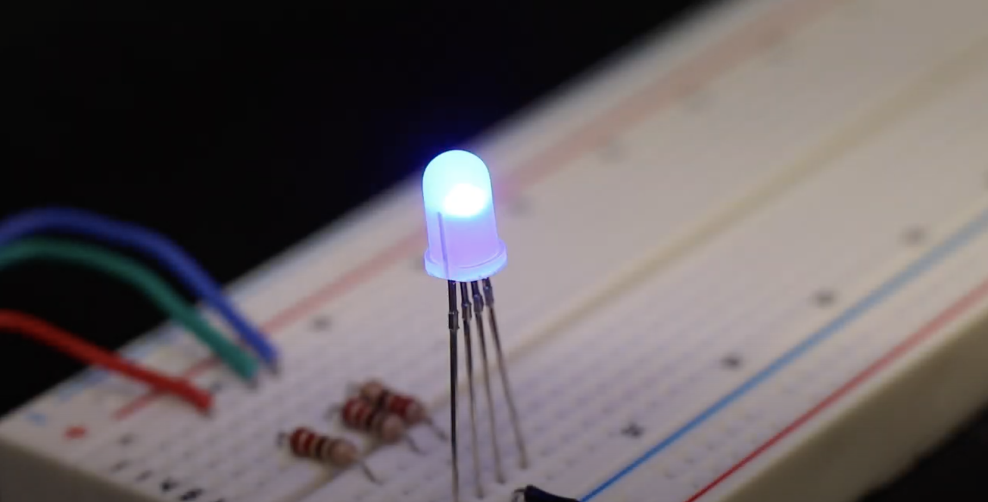
Illuminating Connectivity
At its core, the project involves an LED light connected to a database that reflects the database’s current status through color changes. Imagine having a desktop application with three buttons: red, green, and blue. Each button updates the database status, and the LED light changes color accordingly. Expanding on this, we could develop a Python application that reads the database and changes its color, highlighting the flexibility and adaptability of this concept.
Project members: Me (Jacob Jones), Myself (J. Jones) and I (JJ)

